Slide 1
GUITAR BEGINNER COURSE : week 1

Slide 2
INTRODUCTION

Slide 3
topics for the week
BRIEF DESCRIPTION: ROLES OF GUITAR PLAYERS
GUITAR PARTS
TUNING
LETTER NOTATION
FRETBOARD NOTES
BASIC STRUMMING: 4 COUNTS AND 2 COUNTS
YOUR FIRST CHORDS: C A G E D
YOUR FIRST SONG: LORD I LIFT YOUR NAME ON HIGH

Slide 4
Types and role of guitar players

Slide 5
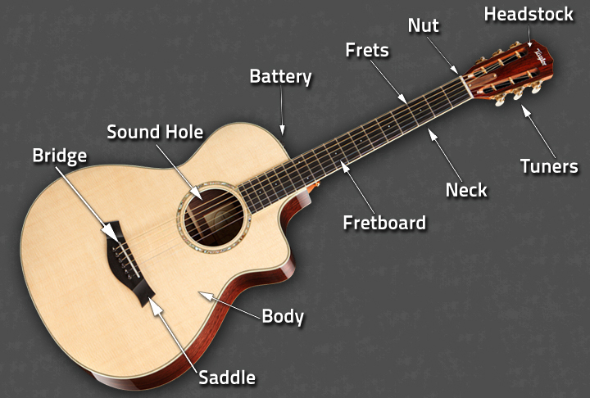
Guitar parts: acoustic

Slide 6
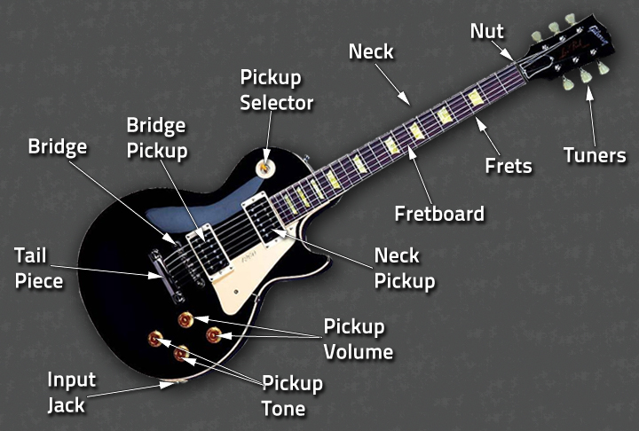
Guitar parts: electric

Slide 7
tuning

Slide 8
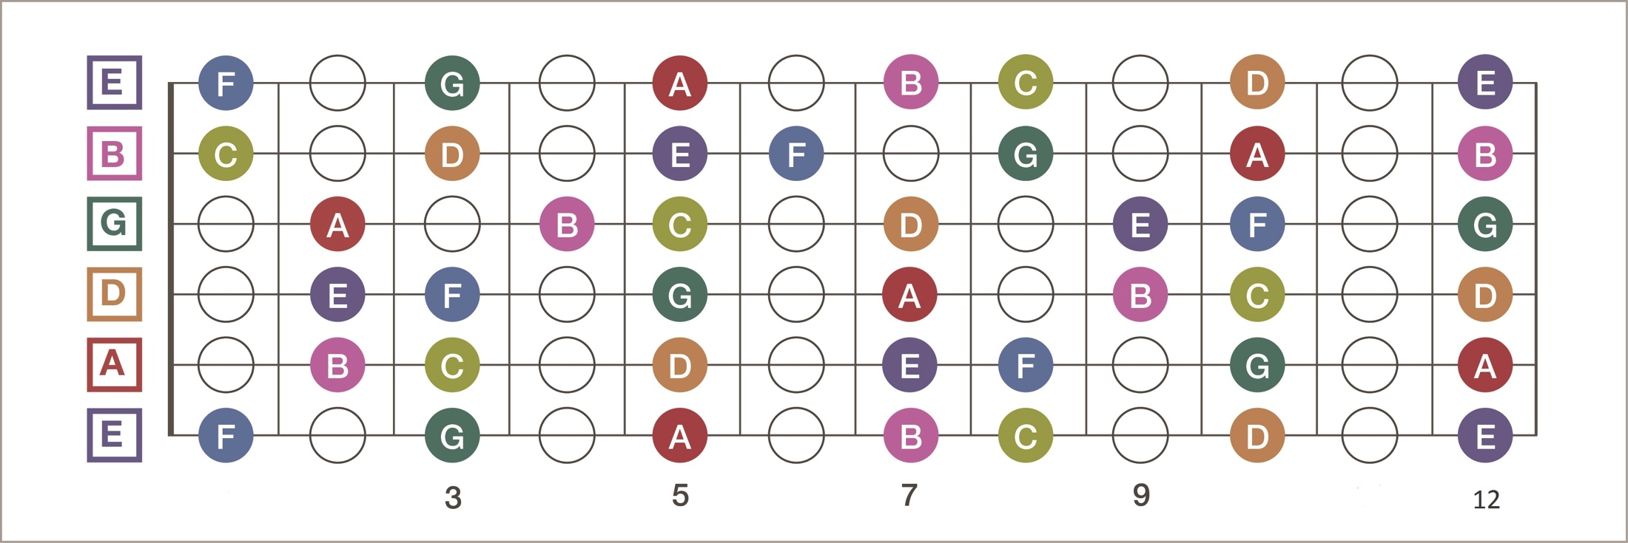
FRETBOARD NOTES

